Slide 1
HW3-解答
李佳伟

Slide 2
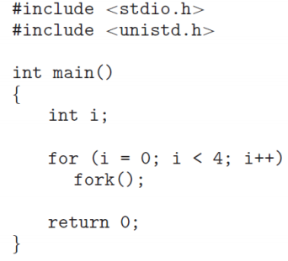
3.1 Including the initial parent process, how many processes are created by the program?
Answer: 16 processes are created.

Slide 3
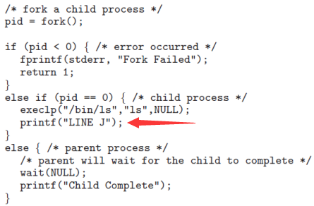
3.2 Explain the circumstances under which the line of code marked printf (‘‘LINE J’’) in Figure 2 will be reached
Answer:
If the call to exec() succeeds, the new program is now running and control from the call to exec() never returns. In this scenario, the line printf("Line J"); would never be performed.
However, if an error occurs in the call to exec(), the function returns control and therefor the line printf("Line J"); would be performed

Slide 4
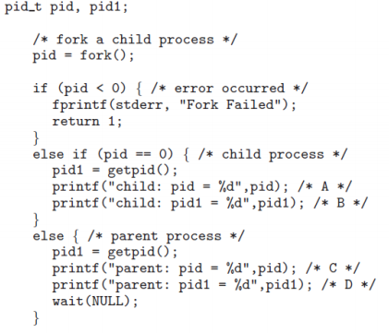
3.3 Using the program in Figure 3, identify the values of pid at lines A, B, C, and D. (Assume that the actual pids of the parent and child are 2600 and 2603, respectively.)
Answer:
A = 0,
B = 2603,
C = 2603,
D = 2600

Slide 5
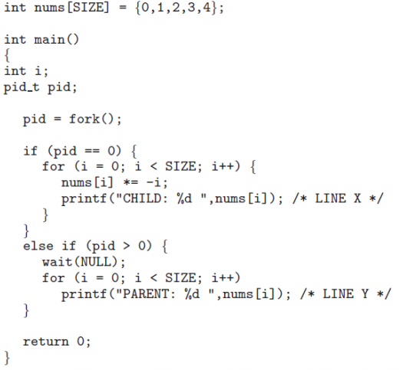
3.4 Using the program shown in Figure 4, explain what the output will be at lines X and Y
Answer:
X are 0, -1, -4, -9, -16.
Y are 0, 1, 2, 3, 4

Slide 6
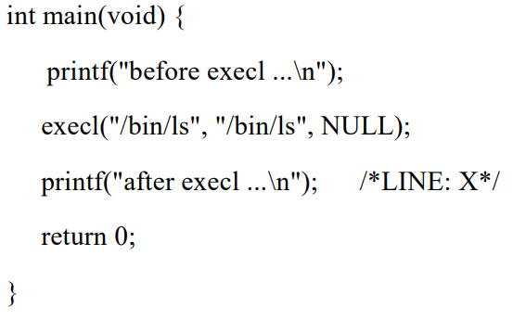
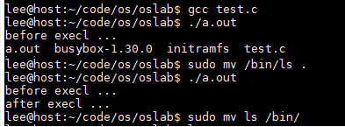
3.5 For the program in Figure 5, will LINE X be executed, and explain why
Answer:
(same to 3.2)

Slide 7
3.7 Explain what is a zombie process and when a zombie process will be eliminated (i.e., its PCB entry is removed from kernel).
Answer:
A zombie process is a process whose execution is completed but it still has an entry in the process table. Zombie processes usually occur for child processes, as the parent process still needs to read its child’s exit status. Once this is done using the wait system call, the zombie process is eliminated from the process table.

Slide 8
3.6 Explain why “terminated state” is necessary for processes.
Answer:
Once the process finishes its execution, its PCB should be removed from main memory. Without “terminated state” , how does the parent process know when to remove the PCB of child process. (if the parent doesn’t call wait() )
(Because the system needs to identify and remove zombie processes)

Slide 9
HW3提交情况
应交人数 | 实交 | 未交
150 | 142 | 8
分数段分布

